Slide 1
Secure data hiding in image using steganography
CAPSTONE PROJECT
Presented By: KOLLURU SAI ABHIRAM
Student Name : KOLLURU SAI ABHIRAM
College Name & Department : VIT-AP UNIVERSITY & BTECH-CSE

Slide 2
OUTLINE
Problem Statement
Technology used
Wow factor
End users
Result
Conclusion
Git-hub Link
Future scope

Slide 3
Problem Statement
Data security and confidentiality are crucial in modern digital communication. Traditional encryption methods make data unreadable, but they can still attract attention. Steganography provides a solution by hiding information within ordinary files, such as images, making the hidden data inconspicuous.
Embed a text message into an image by modifying pixel values.
Protect the hidden message with a passcode.
Retrieve and decode the message only when the correct passcode is provided.
Ensure minimal distortion so that the image remains visually unchanged.

Slide 4
Technology used
Thinkter for GUI version of the code.
This project is implemented using Python (3.x) as the programming language.
The OS library is used for file handling, such as checking image availability.
It uses OpenCV (CV2) for image processing, including loading, modifying, and saving images.
Character encoding and mapping are handled using built-in Python functions like ord() and char().

Slide 5
Wow factors
Steganography-Based Security – Unlike traditional encryption methods, this project hides messages inside images, making the data visually undetectable.
Passcode Protection – The hidden message can only be retrieved using a correct user-defined passcode,
adding an extra layer of security.
Pixel-Level Data Encoding – The message is embedded at the pixel level without significantly altering the image, ensuring secrecy.
Cross-Platform Compatibility – Works on Windows, Linux, and macOS, supporting different Python environments.
Lightweight & Efficient – Uses minimal computational resources compared to cryptographic encryption, making it suitable for low-power devices.
Simple Yet Effective – No need for complex encryption algorithms; instead, it leverages image pixels for secure message storage.

Slide 6
End users
Cybersecurity Professionals – They can use this method for secure communication and covert data transmission.
Journalists & Whistleblowers – Helps in securely sharing sensitive information without detection.
Government & Military – Can be used for secure intelligence sharing and classified communication.
Corporate Organizations – Useful for protecting confidential business data from cyber threats.
Forensic Experts – Helps in hiding critical evidence within images for security purposes.
Privacy-Conscious Individuals – Anyone looking for a secure way to send private messages without raising suspicion.
Academic & Research Communities – Can be used in cryptography and steganography research.

Slide 7
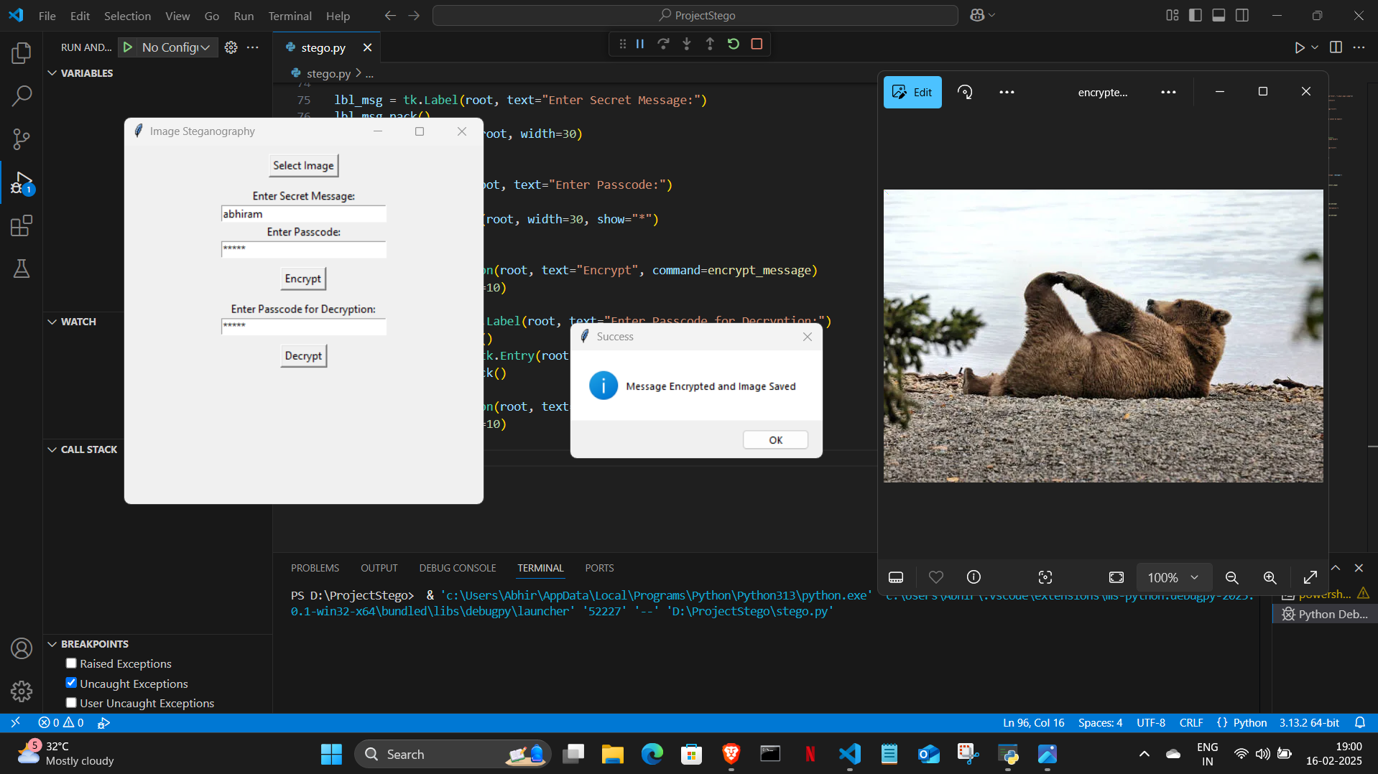
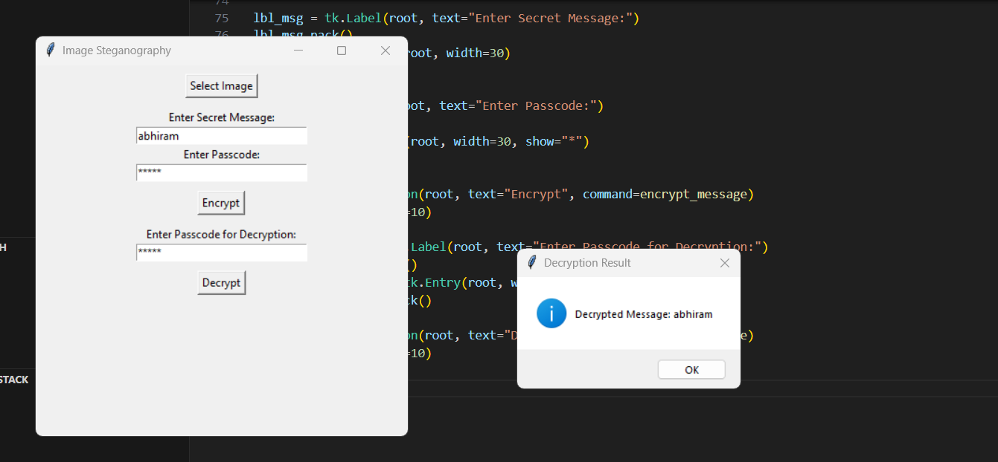
RESULTS(GUI MODE)

Slide 8
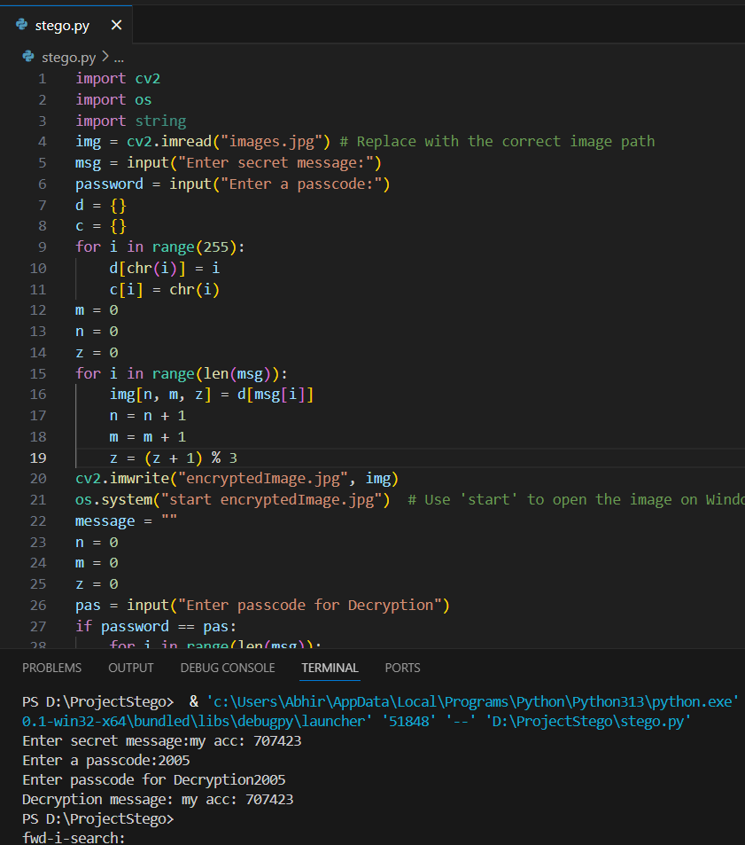
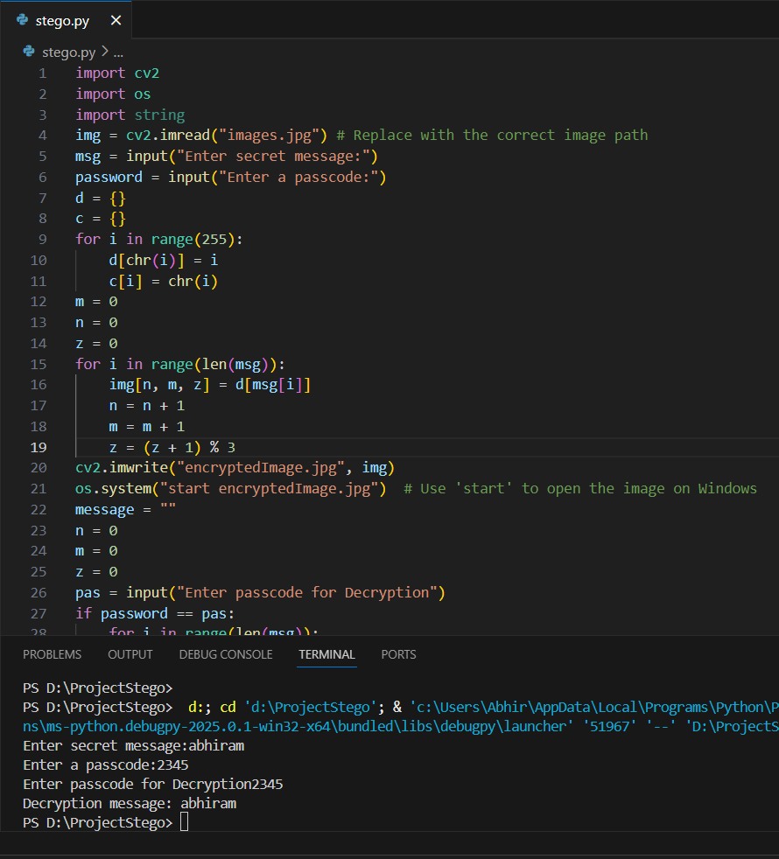
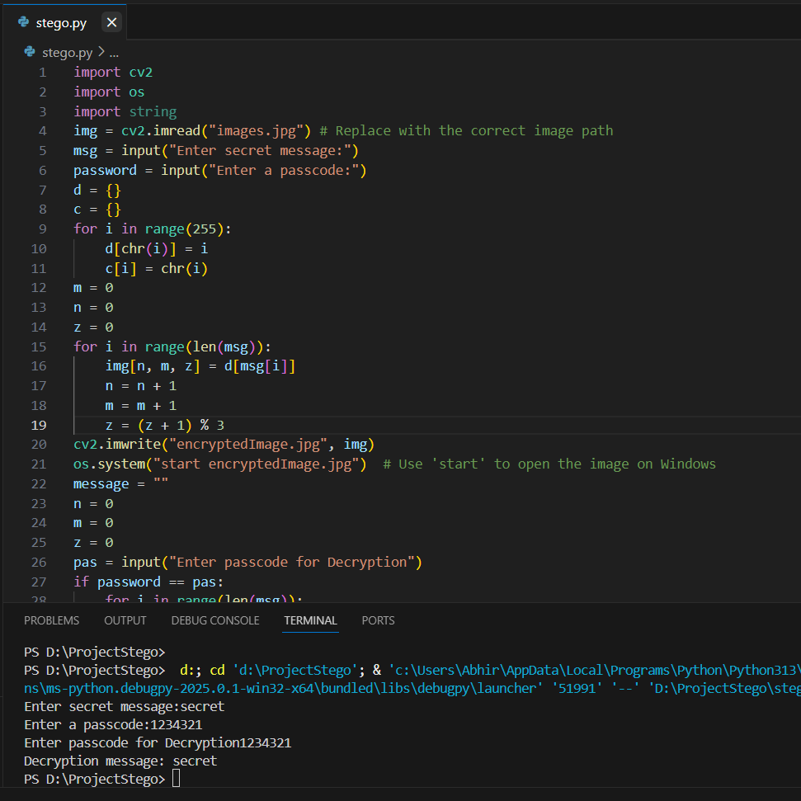
Results (base code)

Slide 9
Conclusion
This project successfully implements image steganography to securely hide and retrieve secret messages within images. By modifying pixel values, it ensures that sensitive data remains imperceptible while maintaining the visual integrity of the image. The addition of passcode protection enhances security, making it accessible only to authorized users. This method provides a lightweight, efficient, and discreet approach for secure communication, offering applications in cybersecurity, journalism, military intelligence, and personal privacy. With further enhancements, such as advanced encryption and AI-based steganalysis, the project can be expanded for even greater security and functionality

Slide 10
GitHub Link
https://github.com/abhiram342-vit/StegoSecure.git

Slide 11
Future scope(optional)
Advanced Encryption Integration – Enhancing security by combining steganography with encryption techniques like AES or RSA for double-layer protection.
Support for Multiple File Formats – Extending functionality to hide messages not only in images (JPEG, PNG, BMP) but also in audio, video, and text files.
Steganalysis Resistance – Implementing AI-based steganography to make hidden data more resistant to detection by forensic tools.
Increased Storage Capacity – Developing methods to embed larger messages without noticeable distortion in image quality.
Cross-Platform Application – Creating a user-friendly mobile or web application to allow easy message hiding and extraction.
Steganography Over Network Transmission – Implementing real-time secure data transmission using steganography for confidential online communication.

Slide 12
THANK YOU

